Slide 1
Lecture 6:
Informed Search(cont’d)

Slide 2
Feasible Solution vs. Optimal Solution
DFS, BFS, hill climbing and best-first search can be used to solve some searching problem for searching a feasible solution.
However, they cannot be used to solve the optimization problems for searching an (the) optimal solution.

Slide 3
A* search
A* search uses an admissible heuristic
  A heuristic is admissible if it never overestimates the cost to reach the goal
  A* search algo evaluate nodes by using the function:
  F(n) = G(n) + H(n)
  G(n) = Cost of two immediate node H(n) = Heuristic
  Are optimistic
    Formally:
    1. h(n) <= h*(n) where h*(n) is the true cost from n
    2. h(n) >= 0 so h(G)>= 0 for any goal G.
    e.g. h_{SLD}(n) never overestimates the actual road distance

Slide 4
A*
Improved version of branch and bound
Take underestimate distance
If not find result within underestimate then we have to increase the estimate just like progressive deepining
On every node shows underestimated distance
Total distance from initial to goal is nine
In example take underestimated distance is not more than 8
Prune more than eight

Slide 5
A*
On underestimate basis we did search step by step
We increases the estimate if goal is not at underestimate
We increases it progressively just like Iterative Deeping search
Not guarantee to succeed every time

Slide 6
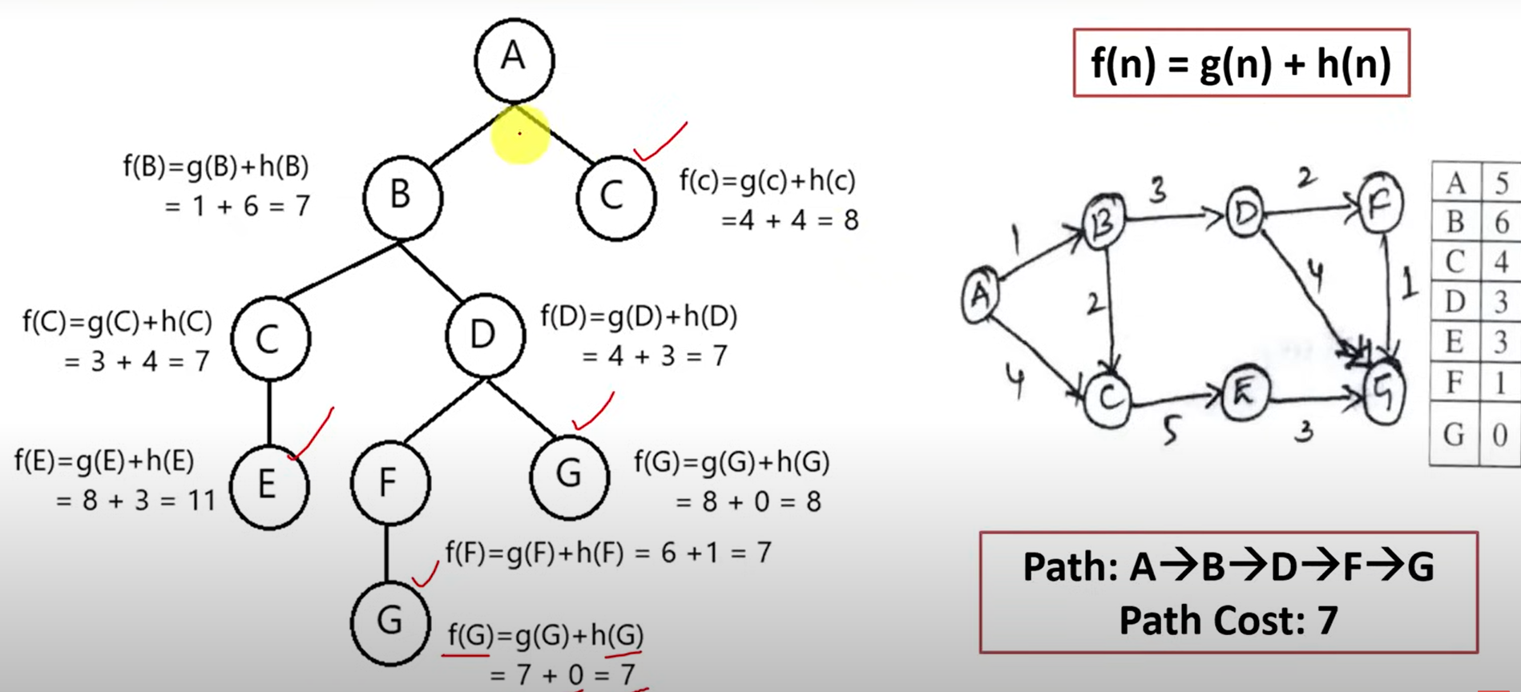

Slide 7
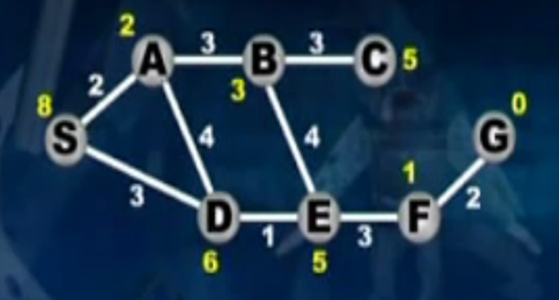
A*

Slide 8
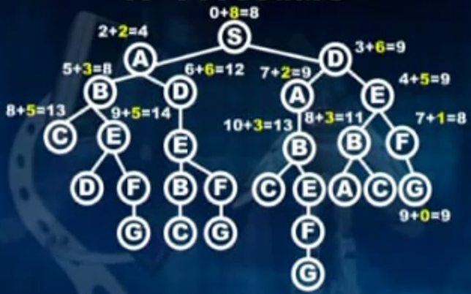
A* ( first under estimate = 8)

Slide 9
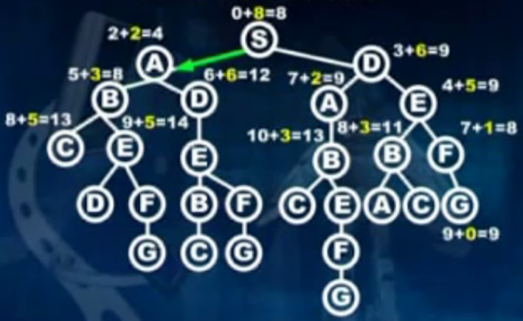
A*

Slide 10
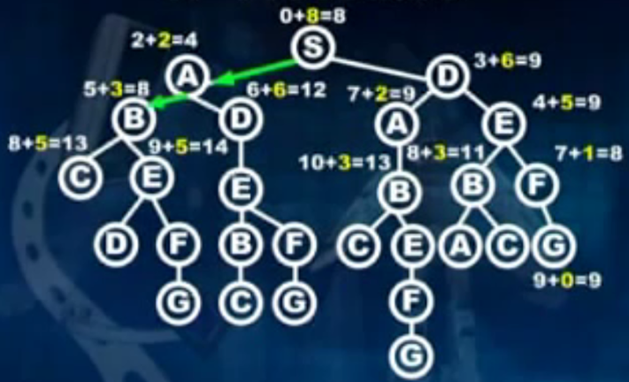
A*

Slide 11
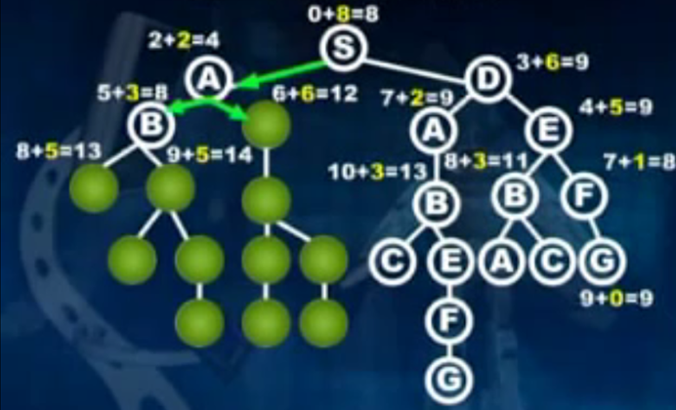
A*

Slide 12
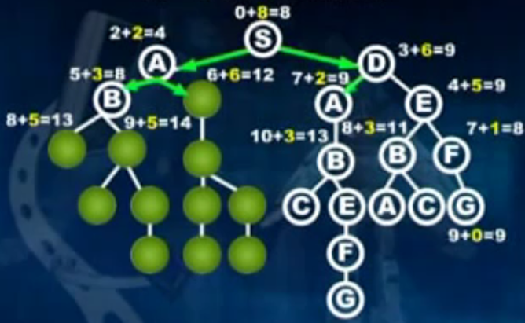
A*

Slide 13
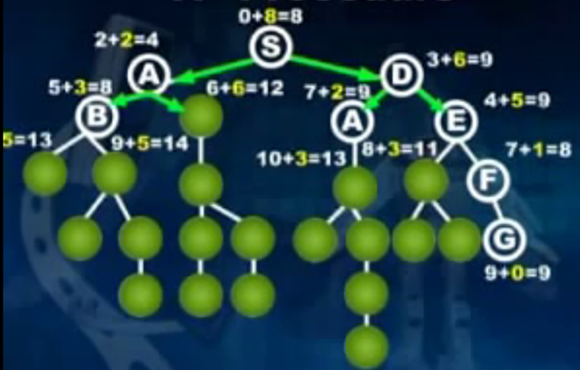
A*

Slide 14
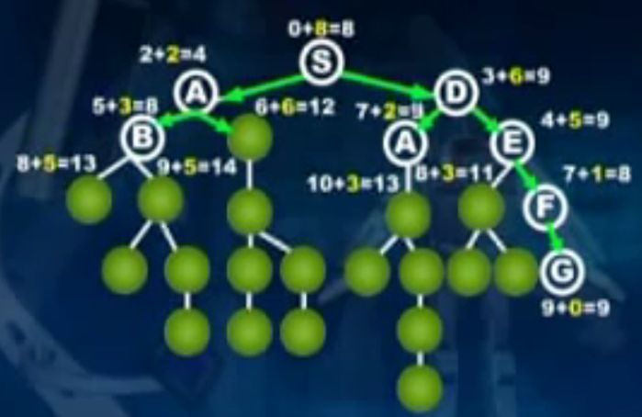
A*

Slide 15
A* search, evaluation
Completeness: YES
Time complexity:
  Number of nodes expanded is still exponential in the length of the solution.

Slide 16
A* search, evaluation
Completeness: YES
Time complexity: (exponential with path length)
Space complexity:
  It keeps all generated nodes in memory
  Hence space is the major problem not time

Slide 17
A* search, evaluation
Completeness: YES
Time complexity: (exponential with path length)
Space complexity:(all nodes are stored)
Optimality: YES
  Cannot expand f_{i+1} until f_{i} is finished.
  A* expands all nodes with f(n)< C*
  A* expands some nodes with f(n)=C*
  A* expands no nodes with f(n)>C*
Also optimally efficient (not including ties)

Slide 18
A*- Example
Goal: find a minimum sum-cost path
Notation:
  g^(n) = cost of current path from start to node n in the search tree.
  h^(n) = estimate of the cheapest cost of a path from n to a goal.
  Special evaluation function: f = g+h
f(n) estimates the cheapest cost solution path that goes through n.
  h(n) is the true cheapest cost from n to a goal.
  g(n) is the true shortest path from the start s, to n.
If the heuristic function, h^, always underestimate the true cost (h^(n) is smaller than h(n)), then A* is guaranteed to find an optimal solution.

Slide 19
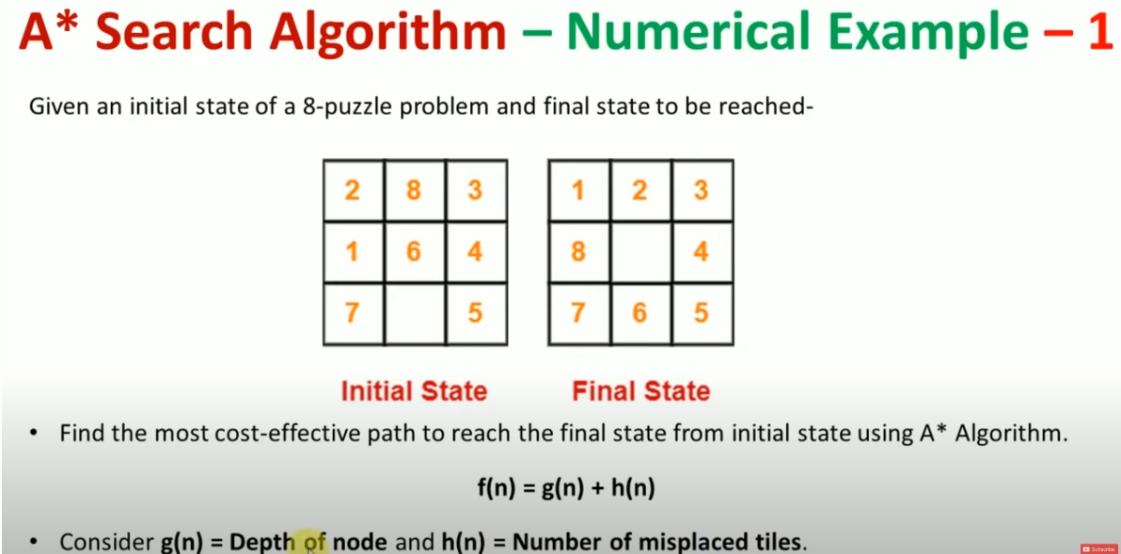

Slide 20
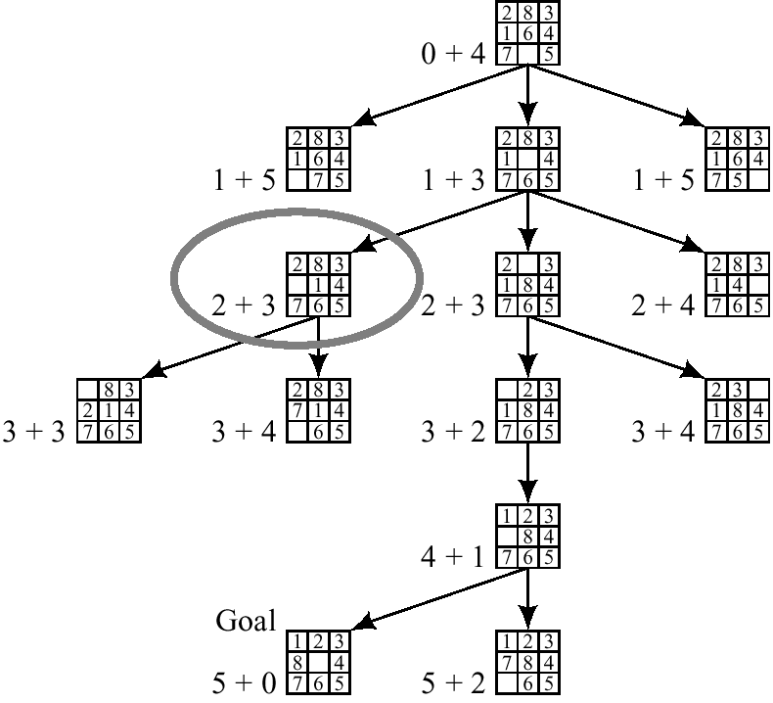
A* on 8-puzzle with h(n) = w(n)

Slide 21
1
4
A
B
C
2
S
2
5
G
5
3
2
4
D
E
F
A
10.4
B
C
6.7
4.0
11.0
G
S
8.9
3.0
6.9
D
E
F

Slide 22
Example of A* Algorithm in action
S
5 + 8.9 = 13.9
2 +10.4 = 12.4
A
D
3 + 6.7 = 9.7
B
D
4 + 8.9 = 12.9
7 + 4 = 11
8 + 6.9 = 14.9
C
E
E
6 + 6.9 = 12.9
Dead End
B
F
10 + 3.0 = 13
11 + 6.7 = 17.7
G
13 + 0 = 13

Slide 23
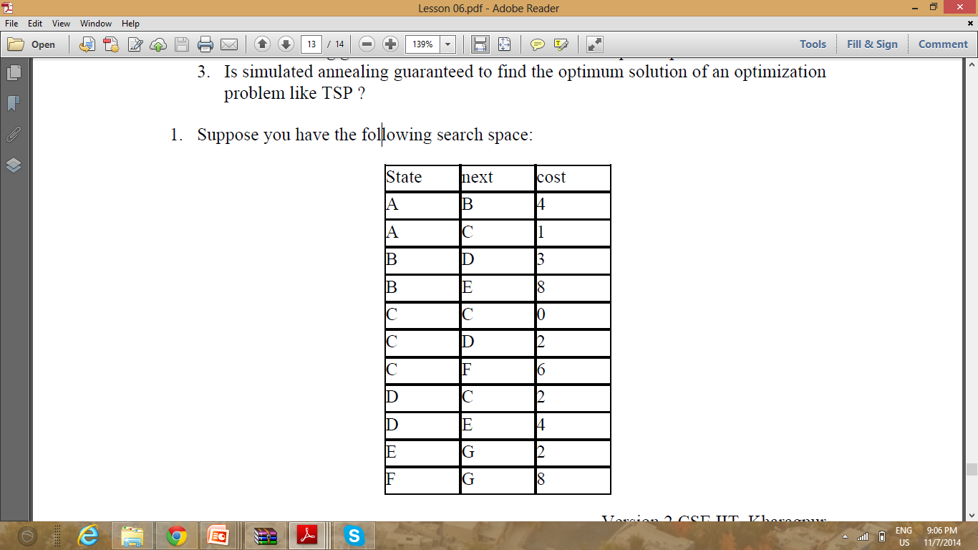

Slide 24
A* Admissible
A* algo find optimal solution if heuristic function is carefully designed and underestimated
Underestimation: Heuristic value is less than less than actual value from Node “n” to goal node
h(n) <= h*(n)
h(n) >= h*(n)
Where h(n) is heuristic values (estimated value)
h*(n) is actual value (or optimal value)

Slide 25
A* Admissible
Suppose you want to purchase mobile, actual price of mobile is 30K
You check in market, go to shop 1 : Your estimation is 40K but actual price is 30K. This is overestimation. What you will do in this situation. Will you purchase or go to next shop. No.
You estimate 20k but actual is 30K. This is Underestimate. Will you go to next shop? Yes.

Slide 26
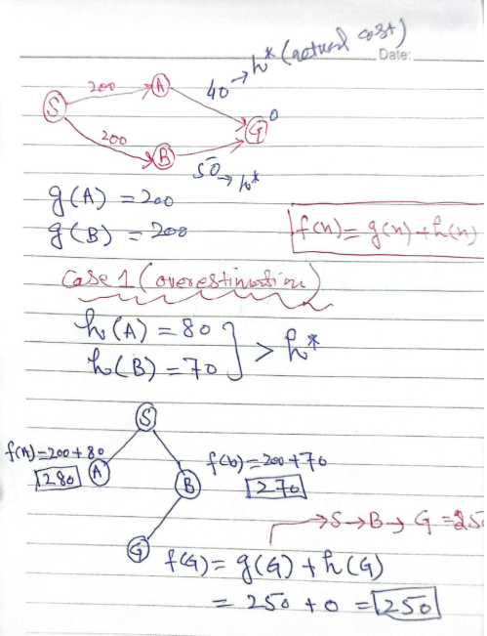

Slide 27
